Slide 1
E-Commerce Database System
Relational Schema Architecture, 3NF Normalization & Live Implementation
Student: Sharfin Zaman Swaccha | ID: 2323713042
Course: CSE311 — Database Management Systems (DBMS)

Slide 2
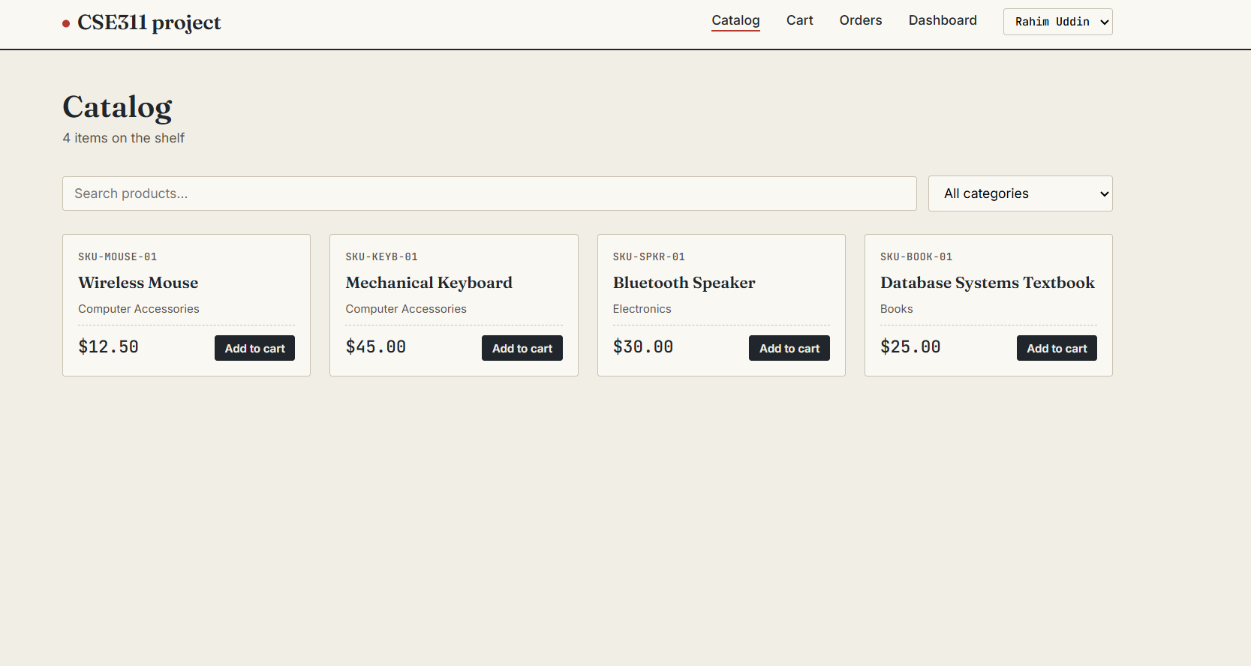

Slide 3
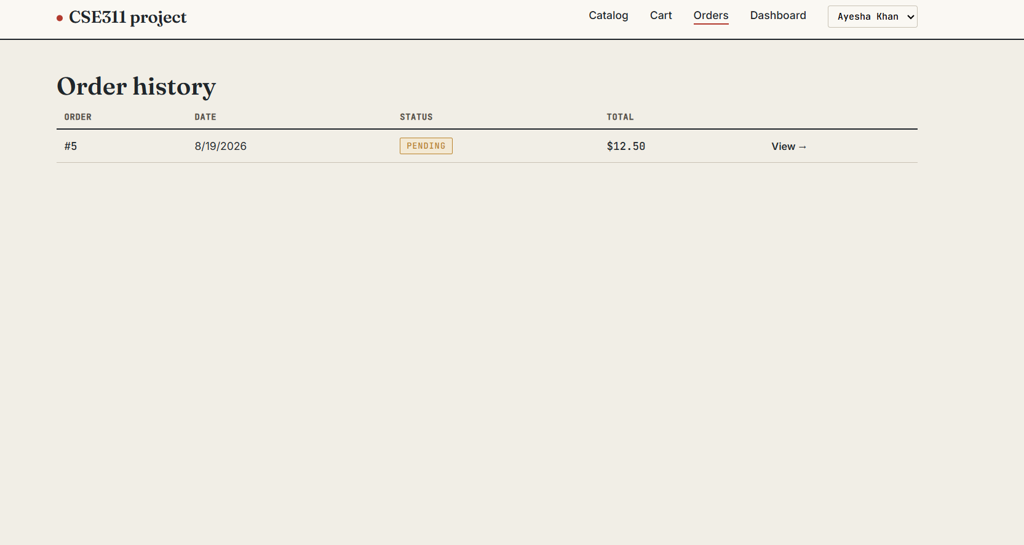

Slide 4
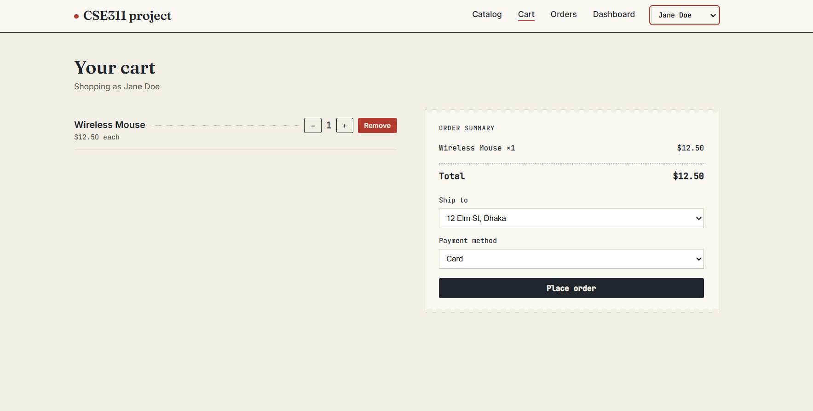

Slide 6
01. OVERVIEW
Introduction & Project Motivation
System Purpose
• Design a robust OLTP relational database for e-commerce transactions.
• Manage user credentials, recursive categories, dynamic shopping carts, and orders.
• Backend designed for CSE311 live project integration.
Core Challenges
• Preventing data redundancy across multi-vendor inventory.
• Preserving historical financial records against future price changes.
• Enforcing strict referential integrity across 12 distinct tables.
Engineering Goals
• 100% compliance with Third Normal Form (3NF / BCNF).
• ACID transactional consistency for cart and order checkout.
• Live analytical query reporting for store managers.

Slide 7
02. THE PROBLEM
Problem Statement: Flaws in Flat/Unnormalized Data
Insertion Anomalies
• Cannot add a new product (e.g. Wireless Mouse) without an active order.
• Cannot onboard new suppliers (e.g. BookHouse BD) without orders.
• Forces dummy NULL values into database.
Update Anomalies
• Updating customer address requires changes in dozens of order rows.
• Changing a supplier cost or catalog price risks corrupting past sales.
• Massive operational overhead & data conflicts.
Deletion Anomalies
• Deleting a cancelled purchase order accidentally erases user accounts.
• Purging old orders can wipe product catalog records entirely.
• Cascading loss of critical business data.

Slide 8
03. NORMALIZATION
Database Normalization Walkthrough: UNF to 3NF
Form | Condition & Transformation | Status / Remaining Issue
UNF | Single flat table with repeating groups in cells like '(Mouse, 2, $10), (Keyboard, 1, $25)' | Violates 1NF; non-atomic data
1NF | Split multi-item cells into individual rows with atomic values | Partial dependency: cust_name depends only on order_id
2NF | Removed partial dependencies by splitting into Order_Tbl and Order_Item | Transitive dependency: address depends on customer
3NF / BCNF | Removed transitive dependencies by separating Customer and Address tables | Full 3NF target achieved; zero data anomalies
Why 3NF / BCNF is the Optimal Standard
• Eliminates all update, insert, and delete anomalies while keeping query joins fast and predictable.
• Avoids over-engineering (no 4NF/5NF multi-valued dependencies exist in standard e-commerce models).

Slide 9
04. RELATIONAL SCHEMA (PART 1)
Database Tables: User, Catalog & Sourcing Entities
Table Name | Primary Key | Foreign Keys (FK) & Target | Key Attributes & Types
customer | customer_id | — | first_name, last_name, email, phone, password_hash, created_at
address | address_id | customer_id -> customer.customer_id | address_line, city, state, zip_code, country, is_default
category | category_id | parent_category_id -> category.category_id | category_name, parent_category_id (Recursive Tree)
supplier | supplier_id | — | supplier_name, contact_email, phone
product | product_id | category_id -> category.category_id | product_name, sku, description, price, stock_quantity, created_at
product_supplier | (product_id, supplier_id) | product_id -> product, supplier_id -> supplier | cost_price decimal(10,2) [M:N Junction Table]

Slide 10
05. RELATIONAL SCHEMA (PART 2)
Database Tables: Cart, Orders, Payments & Reviews
Table Name | Primary Key | Foreign Keys (FK) & Target | Key Attributes & Types
cart | cart_id | customer_id -> customer.customer_id | created_at (Session persistence per user)
cart_item | cart_item_id | cart_id -> cart, product_id -> product | quantity int(11)
order_tbl | order_id | customer_id -> customer, address_id -> address | order_date, status ENUM('PENDING', 'SHIPPED', ...), total_amount
order_item | order_item_id | order_id -> order_tbl, product_id -> product | quantity, unit_price decimal(10,2) [Price Snapshot]
payment | payment_id | order_id -> order_tbl.order_id | payment_method ENUM('CARD','COD',...), amount, status ENUM
review | review_id | product_id -> product, customer_id -> customer | rating tinyint(4), comment text, review_date

Slide 11
06. TECHNICAL HIGHLIGHTS
Key Technical Design Highlights
Price Snapshotting
• order_item stores unit_price as decimal(10,2) at checkout.
• Guarantees future catalog price changes never alter past receipts.
• Essential for legal audits and accounting compliance.
Multi-Payment Architecture
• 1:M relationship between order_tbl and payment.
• Supports CARD, MOBILE BANKING, COD, and WALLET.
• Allows partial, split, or multi-tender settlement.
Recursive Categories & Rules
• Self-referencing parent_category_id FK.
• Enables unlimited category depth (Electronics > PC > Mouse).
• ON UPDATE RESTRICT & ON DELETE CASCADE enforce strict integrity.

Slide 12
07. FRONTEND IMPLEMENTATION
Application Showcase: Catalog, Cart & Orders
Live Product Catalog (Catalog View)
• Integrated with dynamic SQL queries pulling from product & category.
• Sample Products displayed: Wireless Mouse ($12.50), Mechanical Keyboard ($45.00), Bluetooth Speaker ($30.00), Database Systems Textbook ($25.00).
• Keyword search and category dropdown filter normalized tables in real-time.
• Add-to-cart inserts/updates into cart and cart_item tables.
Order History & Checkout Flow
• Checkout moves active cart_items into immutable order_item rows.
• Live Order Tracking: Order #5 | Date: 8/19/2026 | Total: $12.50 | Status: PENDING.
• User profile session switching (e.g., Rahim Uddin, Ayesha Khan).
• Foreign key constraints guarantee orders attach to verified customer addresses.

Slide 13
08. STORE METRICS & QUERIES
Application Showcase: Store Analytics Dashboard
Dashboard Metric Box | SQL Underlying Query / Tables | Live Project Values (Screenshot Data)
Top Spenders | SUM(total_amount) JOIN customer GROUP BY customer_id | Jane Doe ($70.00)
Best Sellers | SUM(quantity) JOIN product GROUP BY product_id | Textbook (10 sold), Mouse (4 sold), Keyboard (2 sold)
Product Ratings | AVG(rating), COUNT(*) FROM review GROUP BY product_id | Wireless Mouse (5★), Mechanical Keyboard (4★)
Low Stock (< 50) | SELECT product_name, stock_quantity WHERE stock < 50 | Database Systems Textbook (30 left)
Inactive Customers | customer LEFT JOIN order_tbl WHERE order_id IS NULL | Rahim Uddin (rahim.uddin@mail.com)
Payment Summary | COUNT(payment_id), SUM(amount) WHERE status='SUCCESS' | 5 Successful Payments ($390.00 Total)
Supplier Cost List | SELECT supplier_name, product_name, cost_price | BookHouse BD ($15.00), TechSource Ltd ($8.00 / $30.00)

Slide 14
09. CONCLUSION
Summary & Key Project Takeaways
3NF & BCNF Certified
• Eliminated all insertion, update, and deletion anomalies.
• 12 fully normalized tables connected via strict FK constraints.
• Zero redundant records; guaranteed ACID compliance.
Full Stack Tested
• Connected seamlessly with the CSE311 project web interface.
• Supports end-to-end shopping: Catalog -> Cart -> Order -> Payment -> Review.
• Accurate historical tracking via price snapshotting.
Student Info
• Name: Sharfin Zaman Swaccha
• Student ID: 2323713042
• Course: CSE311 (Database Management Systems)
• Solid schema modeling ensures scalable database performance.

